Slide 1
The Renaissance Wednesday Oct. 5
Objectives:
Explain how interest in classical learning and religious reform contributed to increased global interaction.
Warm-Up Question:
Read; The Courtier (answer qts. 1-3)
Agenda:
Return Unit 4 TEST: The Middle Ages
PPT Notes: The Renaissance (Artists)
DaVinci Drawing
Homework:
Goal Sheet, Unit 5: The Renaissance & Reformation: Due Tuesday Oct. 11
Quiz: The Renaissance and Reformation: Tuesday, Oct. 11

Slide 2
The Renaissance Outcome: The Renaissance in Italy

Slide 3
The Renaissance
The Middle Ages Ends
Europe is starting to take shape with England, France, and regions in Italy all evolving
Revival of culture
Return to cities
The Church was still powerful
Writers and artists began to express new ideas and styles

Slide 4
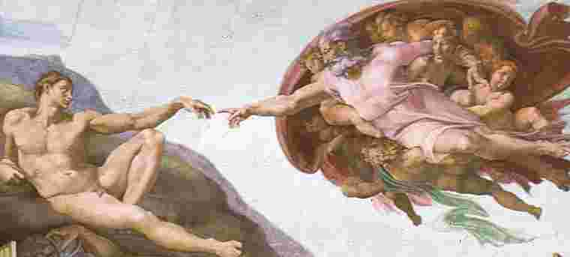
The Renaissance
What is the Renaissance?
Renaissance: Rebirth in art, writing, architecture, learning, and culture.
The educated hoped to bring back to life the culture of classical Greece and Rome
In doing so, they created something entirely new: innovative styles of art and literature
The Renaissance eventually spread from northern Italy to the rest of Europe
Occurred roughly 1300-1600

Slide 5
The Renaissance
Why Italy?
Italy had 3 distinct advantages
City-States
Overseas trade, spurred by the Crusades had led to growth of large city-states
Thus, northern Italy was urban while the rest of Europe was still rural
Cities were the place where people exchanged ideas and the site of an intellectual revolution
Survivors of plague could demand higher wages
Merchants had few opportunities to expand business so they pursued art

Slide 6
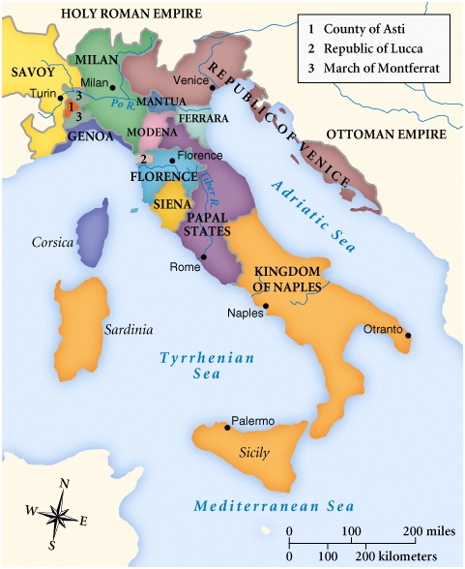
City States
Florence was the epicenter of the Italian Renaissance.

Slide 7
The Renaissance
Merchants and the Medici
A wealthy merchant developed in each Italian city-state
Merchants dominated politics
Merchants did not inherit social rank- used their wits to survive
This lead to the rise of importance of individual merit
The Medici banking family came to dominate Florence
Had branch offices all throughout Italy and Europe
Cosimo de Medici was the wealthiest European of his time
Grandson Lorenzo de Medici became great patron of the arts
Patron: someone who financially supports an artist or the arts

Slide 8
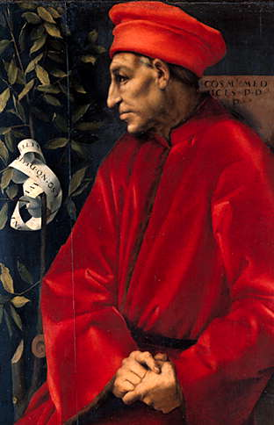
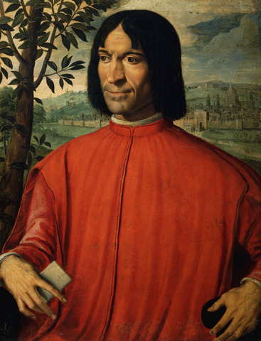
Cosimo de Medici & Lorenzo de Medici

Slide 9
The Renaissance
Classical heritage of Greece and Rome
Renaissance artists looked down on the art and literature of the Middle Ages
Instead they wanted to revive the learning of the Greeks and Romans
Ruins of Rome were nearby
Many Greek manuscripts made their way to Rome via Christian scholars

Slide 10
The Renaissance
Classical and Worldly Views
As scholars studied manuscripts, they became more influenced by classical ideas.
This lead to:
Humanism: an intellectual movement that focused more on human potential and achievements
Popularized the study of history, literature, and philosophy (all are known as humanities)
Worldly pleasure: Humanists suggested that a person could enjoy life without offending God
Ex. Wealthy could enjoy material luxuries, good music, and fine foods

Slide 11
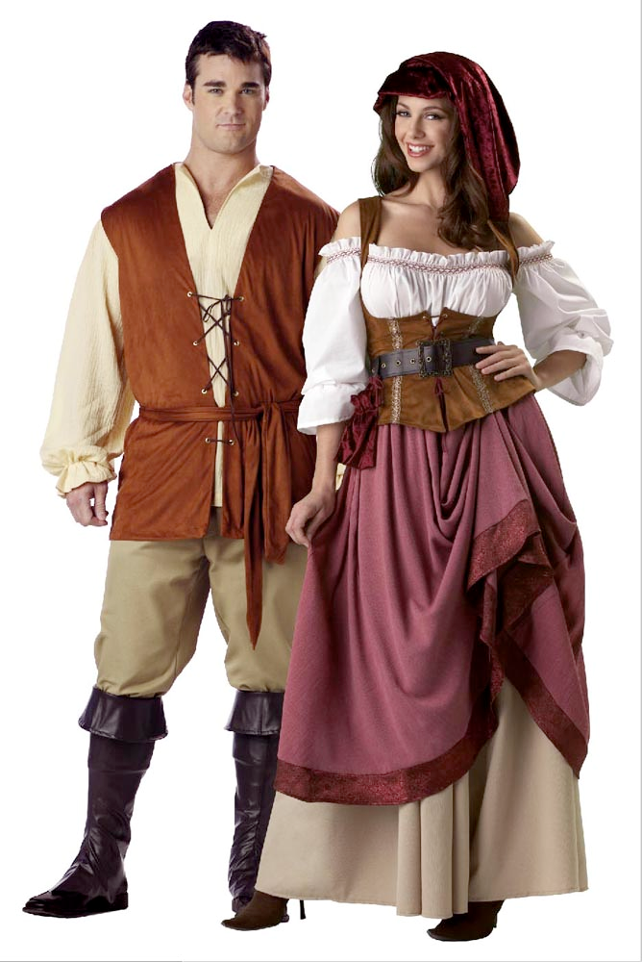
The Renaissance
The Renaissance Man and Woman
Renaissance Man: One strove to be a master in every area of study
Expected to be charming, witty, and well educated in the classics
Also should be a skilled rider, wrestler, and swordsman
Renaissance Woman: Upper-class women should know the classics and be charming
Not expected to seek fame
Inspire art but not create it
Little influence in politics

Slide 12
Minutes 11:30 - 17:30 and 27:00 - 32:00

