Slide 1
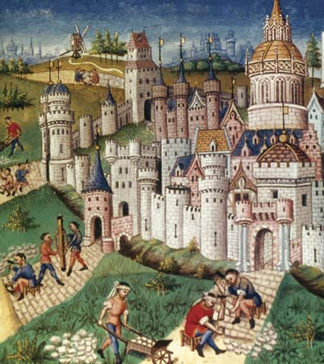
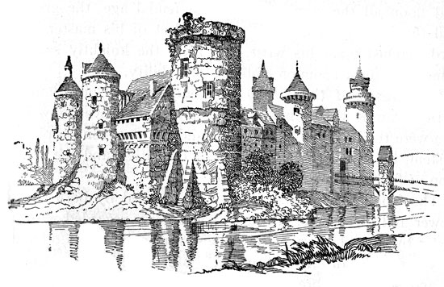
Unit 4: The Middle Ages Day 1
The Middle Ages

Slide 2
Unit 4: The Middle Ages
Monday 9/26
Objective:
Explain what factors led to the Middle Ages and the development of feudalism.
Warm-Up Question:
If our American government disappeared today, how would our lives be different tomorrow?
Agenda:
Review Unit 3 TEST: Greece and Rome
Map Activity: The Middle Ages
PPT/Notes: Causes of the Middle Ages and Charlemagne
Homework:
Goal Sheet, Unit 4: The Middle Ages. Due Tue. 10/4
TEST: Unit 4, The Middle Ages: Tuesday 10/4

Slide 3
Causes/Effects of the Middle Ages
The Middle Ages: What is it?
Time period that existed between the Roman Empire and the Renaissance.
Other names: The Dark Ages or medieval period.
Often seen as a very bleak and dangerous period

Slide 4
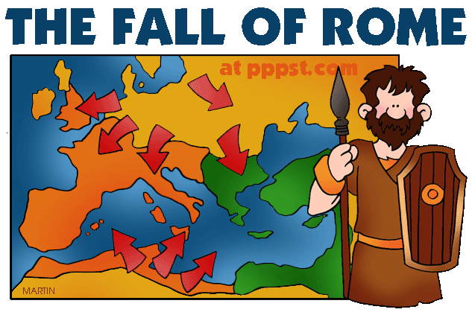
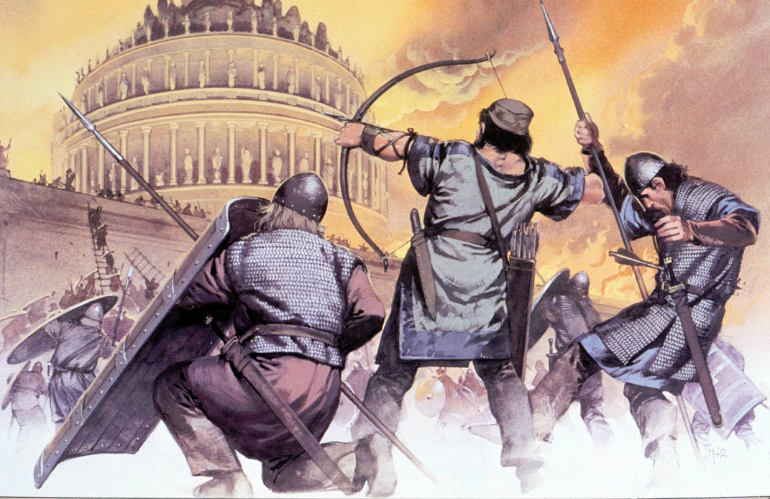
Fall of Rome

Slide 5
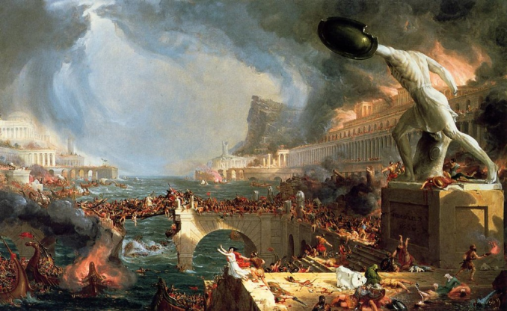
Causes/Effects of the Middle Ages
Causes of the Middle Ages
Fall of Rome
Invasions
Disruption of Trade: Merchant trade collapsed and Europe’s economic centers were destroyed. Money became scarce.
Downfall of cities: Cities were abandoned as centers of administration.

Slide 6
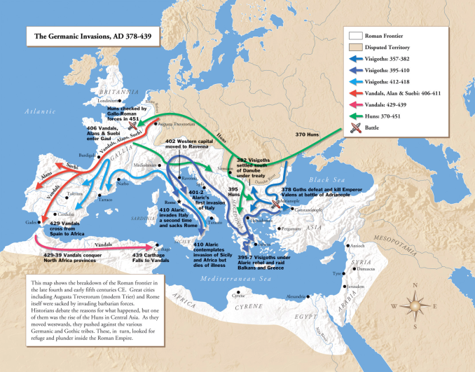
Causes/Effects of the Middle Ages
Invasions
Decline of learning: Germanic invaders could not read or write. Learning became less important as people moved to rural areas.
Loss of a common language: Latin changed as Germanic people mixed with Roman population.

Slide 7
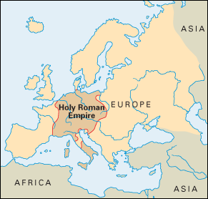
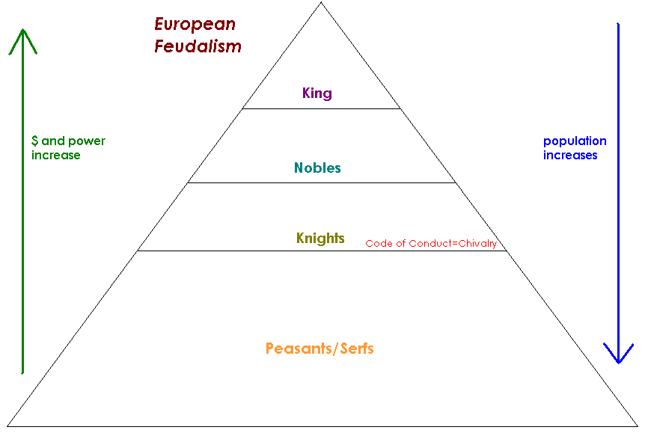
Causes/Effects of the Middle Ages
Effects/Impact of the Middle Ages
New Germanic Kingdoms Emerge (Holy Roman Empire)
Rise of the feudal system in Europe

Slide 8
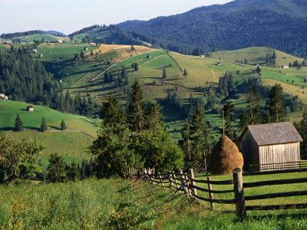
Causes/Effects of the Middle Ages
Effects of the Middle Ages
The power of the Christian Church (Catholic) grows rapidly
Europe became rural (safer?)

Slide 9
Causes/Effects of the Middle Ages
Effects of the Middle Ages
e. Early signs of modern European countries start to appear (England & France)

Slide 10
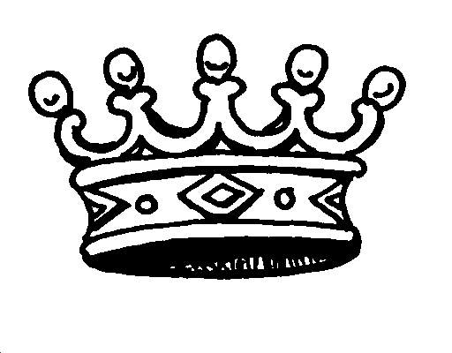
Centralized Government (Roman Empire)
Governor
Governor
Governor
Governor
Governor
Governor
$
$
$
$
$
$

Slide 11
Decentralized Government (fall of the Roman Empire)
Governor
Governor
Governor
Governor
Governor
Governor
King
$
King
King
$
$
$
$
King
King
$
King

Slide 12
Centralized vs. decentralized governments
Centralized Roman Government
Same laws
Same language
Same government
Central government paid governors directly
Same religion
Decentralized Government Middle Ages
Different laws
Different languages
Different government
Local lords get paid from locals (self-sufficient)
Same religion

Slide 13
Germanic Kingdoms Emerge

Slide 14
Charlemagne

Slide 15
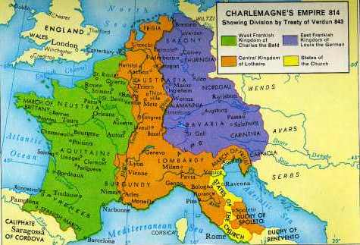
Charlemagne
Charlemagne Becomes Emperor
Pepin the short died in 768
Charles the Great, better known as Charlemagne takes over in 771
Imposing figure standing 6 foot 4 inches tall

Slide 16
Charlemagne
Charlemagne as King
Was now the most powerful king in Western Europe
Charlemagne built an empire greater than any known since the Romans
His conquests against the Muslims to the south and east spread Christianity
He united Western Europe for the first time since the Roman Empire
The empire became known as the Holy Roman Empire
Charlemagne strengthened his power by weakening power of the nobles
Sent out royal agents to check on powerful landowners
Regularly visited his kingdom
Encouraged learning- surrounded himself with scholars and opened new monasteries

Slide 17
Germanic Kingdoms Emerge
In 800, he traveled to Rome to protect the pope → the pope rewards Charlemagne by crowning him emperor
This historic coronation showed that the pope had more power than the king
Charlemagne died in 814, his grand sons split up the kingdom- bad idea
Carolingian kings lost power and authority broke down
This lead to the rise of feudalism
Read: Charlemagne

Slide 18
Unit 4: The Middle Ages
Tuesday 9/27
Objective:
Explain what factors led to the Middle Ages and the development of feudalism.
Warm-Up Question:
Read Charlemagne. Answer questions 1-3
Agenda:
PPT/Notes: The Feudal System and The Manor
Simulation: Feudalism
Activity (With a partner): Feudal Contract and The Manor
Homework:
Goal Sheet, Unit 4: The Middle Ages. Due Tue. 10/4
TEST: Unit 4, The Middle Ages: Tuesday 10/4

Slide 19
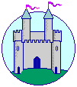
The World of Lords and Vassals
Causes
Governments could not defend people
subordinates (vassals) found a powerful lord who could protect in exchange for service (usually military)
Feudalism
Depended on the control of land
King/Lord granted land (fief) to the vassal/lesser lord
Vassal/lesser lord provided his fighting skills and loyalty to lord
Upon death, the fief was supposed to revert to the lord in practice it was inherited by the eldest son

Slide 20
Feudal Society
The feudal system was based on mutual obligations.
In exchange for military protection and loyalty, a lord, would give a fief to a vassal

Slide 22
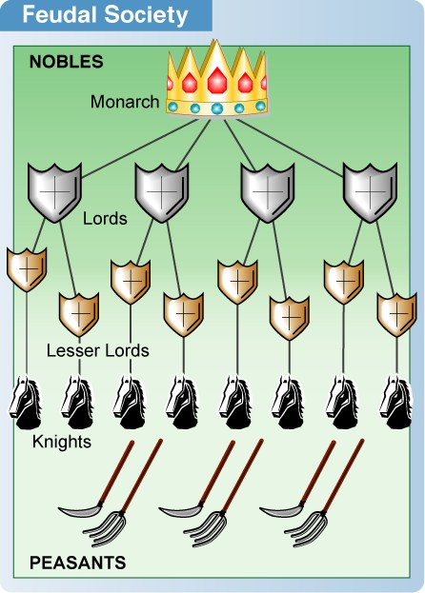

Slide 23
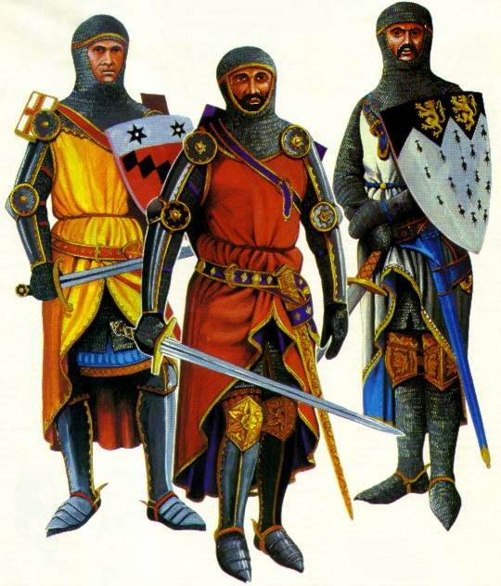
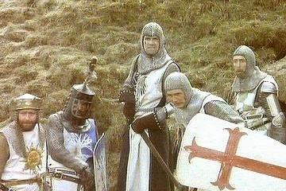
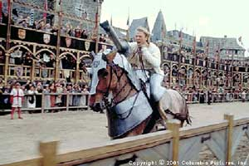
The Knights
Anyone Know the Movie??

Slide 24
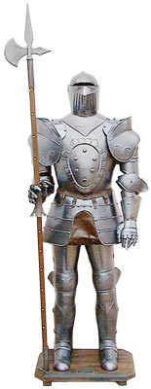
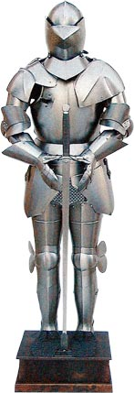
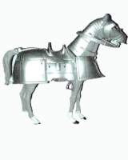
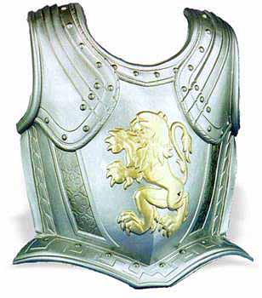

Slide 25
The Age of Chivalry
Knights were mounted horsemen who pledged to defend their lords’ lands in exchange for fiefs. They were expected to display courage in battle and loyalty to their lord.
1100’s → chivalry, a code of conduct and a complex set of ideals;
Demanded that a knight fight bravely for his three masters; (1) feudal lord, (2) heavenly Lord, (3) his chosen lady
Also protect the weak and the poor
Education started at age 7 (page), then 14 (squire), finally at 21 (knighthood)

Slide 26
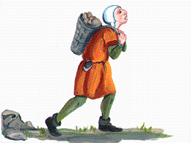
Manorial System
The Manor
an agricultural estate operated by a lord
worked by peasants
Lords provided protection
peasants gave up freedom
Serfs
By the 9th century around 60% of the population
could not be bought and sold
were subject to their lord
had to pay rent to the lord
pay a tithe (10% of produce) to the church
pay for the use of pastures,
streams, woods, etc.

Slide 27
Manorial System
Peasants rarely travelled more than 25 miles from their own manor
Could see their whole world in front of them
Typically consisted of lord’s manor house, a church, and workshops
Fields, pastures, and forests surrounded the village
Along with streams, wells, ponds
Extremely self-sufficient
Serfs and peasants raised or produced nearly everything that they and their lord needed for daily life
Only outside purchases were salt, iron, and a few unusual objects

Slide 28
Where is the loyalty?
Lord Arnold receives a fief from King John to keep him on the side of King John. Lord Arnold gives part of the land to a lesser lord, Lord Richard. Lord Richard then gives the land to a knight, Sir Jack, who turns around and gives part of the land to two families, the Smiths and the Wessons.
Lord Richard is vassal to who?
Sir Jack is a vassal to John, Richard, or Arnold?
Which lord would the Smiths and the Wessons be loyal to?
Lord Arnold is loyal to who?
Who must King John keep happy?

Slide 29
Lord Henry is a shrewd ruler who would like to expand his power and hopefully one day become king. What must he do in order to break the line of the current Kings?
Matt wishes to visit a cousin on another manor. Can he?

Slide 30
Read: Life on the Manor
Simulation: Feudalism

Slide 31
Feudalism Simulation
King= person with highest class average
Green Stickies= Knights
Yellow Stickies= Nobles/Lords
Everybody else= peasant
You will receive your harvest (7 starbursts).
Do not eat your harvest!!!!!!!!

Slide 32
Procedures
King will grant the nobles/lords a fief in the classroom
Nobles/Lords will order their Knights (vassals) to collect a tax (6 starbursts)from each peasant on your fief
The Knight may keep 1 starburst per peasant and give the remaining to the Noble/Lord.
Nobles/Lords may keep 2 starburst per peasant and give the rest to the King.

Slide 33
Procedures continued
Now, everyone must give 10% of their resources (tithe) to their local priest (that’s me ☺).
Everyone count your resources (starbursts)

Slide 34
Reflection Questions
How do you feel about what you received?
In what direction are the resources flowing?
Is the system fair? Explain.
Why would a peasant put up with this system and not revolt?

Slide 35
Create your own manor…
With a partner you are going to create a feudal contract and a medieval manor.
There are 10 necessary things that you need to include on your manor.
You can use the map on page 362 to help guide you but it is not a tell-all source of what you need.
Village (homes for serfs)
Manor House (lords home)
Church/Priest House
Mill
Water Source
Three-Field System
Forest
Orchard
Oven/Blacksmith
Roads

Slide 36
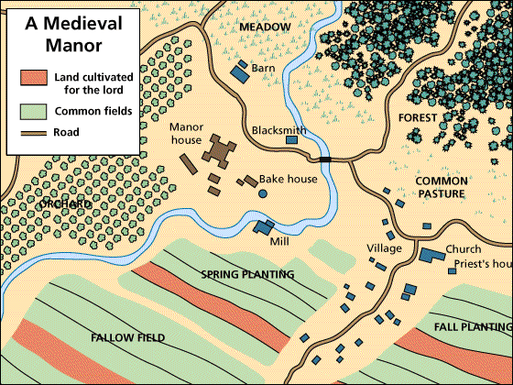

Slide 37
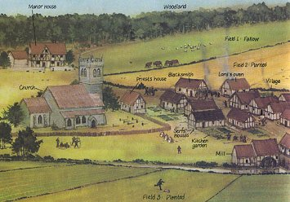

Slide 38
Unit 4: The Middle Ages
Monday 2/22
Objective:
Explain what factors led to the Middle Ages and the development of feudalism.
Warm-Up Question:
Handout: Feudal System & Manor System Review
Blue book: Pages 353 and 360-361.
Agenda:
Feudalism Simulation
Create: Feudal Contract and the Manor (with a partner)
Homework:
Goal Sheet, Unit 4: The Middle Ages. Due Mon. 2/29
TEST: Unit 4, The Middle Ages: Mon. 2/29

