Slide 1
The Earliest Humans
Outcome: Rise of Civilization & Mesopotamia

Slide 2
Constructive Response Questions
What are the characteristics that make up a civilization?
Describe the geography of Mesopotamia.

Slide 3
What will we learn?
Villages grow into cities.
The 5 Characteristics that make up a civilization
Mesopotamia & Sumer

Slide 4
Cornell Notes Lecture, reading/chapter/novel/article during class, power point, movies (if need to collect info.) Topic:_______________________ Questions/Main Ideas: | Name: ___________________________________ Unit: _________________ Day: ________ Date: ____________________________ Notes:
Summary:

Slide 5
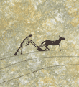
Rise of Civilization & Mesopotamia
Setting the Stage
How did Agriculture change life for humans?
Began dwelling in larger, more organized communities
Cities gradually grew
Economics began to matter

Slide 6
Rise of Civilization & Mesopotamia
Villages Grow into Cities
Farming became easier due to advances in technology and domestication of animals
Bigger harvests also resulted from better technology
Fact: The more food you have in supply, the bigger the population that can be supported
As cities grew, so did responsibilities ---> not everyone farmed anymore
The wheel and the sail allowed trade to occur over longer distances
No currency yet
Social Classes began to emerge
Religion became more organized

Slide 7
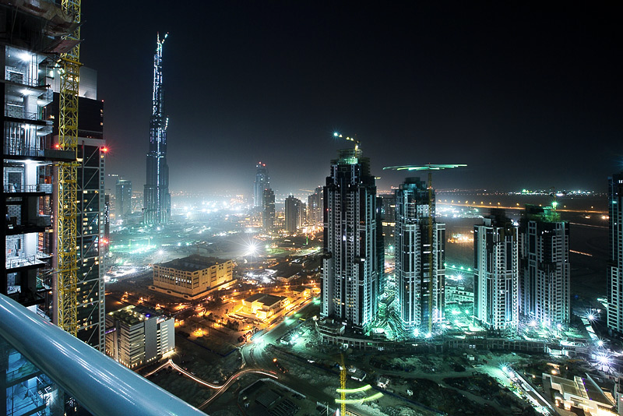
Rise of Civilization & Mesopotamia
How Civilization Develops
A Civilization is a complex culture with 5 characteristics
Advanced Cities
Size alone does not distinguish a city from a village
Must be a center for trade

Slide 8
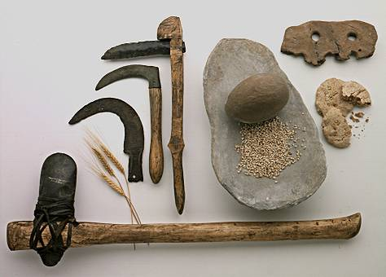
Rise of Civilization & Mesopotamia
Specialized Workers
Specialization: the development of skills in a specific kind of work
Artisans: skilled workers who make goods by hand

Slide 9
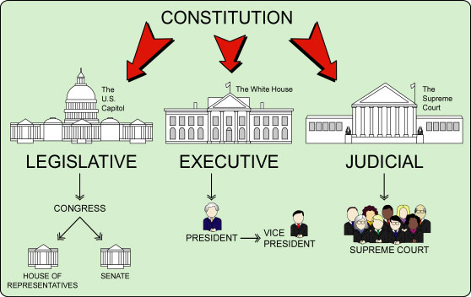
Rise of Civilization & Mesopotamia
Complex Institutions
Institution: a long-lasting pattern of organization in a community
Ex: Government, religion, and the economy

Slide 10
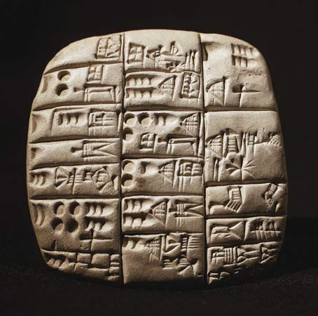
Rise of Civilization & Mesopotamia
Record Keeping
Ex. Tax collecting, passage of laws, storage of grain
Around 3000 B.C. Sumerian scribes (professional record keepers) invented a writing system called cuneiform.
Cuneiform: wedge shaped point pressed into wet clay to make symbols. P. 21

Slide 11
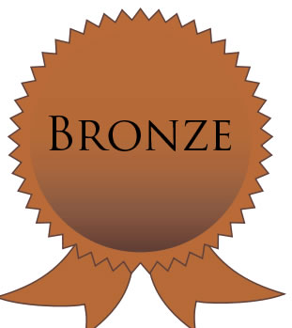
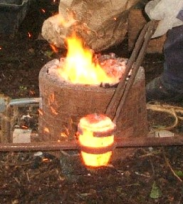
Rise of Civilization & Mesopotamia
Advanced Technology
Ex: Ox drawn plows, potters wheel, using bronze
Melt copper and tin together = bronze
(more durable and malleable)

Slide 12
Ancient Mesopotamia/Sumer Friday 9/2
Objective:
Describe Sumerian religious beliefs, social structure, and technology.
Explain the influence of Sumer on later civilizations.
Warm-Up Question:
How did the Nile shape the lives of the ancient Egyptians
Agenda:
PPT/Notes: Mesopotamia/Sumer
Read: Hammurabi’s Code. Answer questions that follow.
Map Activity
Homework:
Map Activity: Due Friday 9/9
DBQ Activity: Ancient Egypt: Due Tuesday 9/6
Goal Sheet, Unit 1 & 2: Due Tuesday 9/13
TEST, Unit 1 & 2: Due Tuesday 9/13

Slide 13
Mesopotamia
Also known as The Fertile Crescent

Slide 14
Why was the Fertile Crescent called the “Crossroads of the World”?

Slide 15
Mesopotamia/Sumer
Geography of Mesopotamia
Located in modern day Iraq
Rich land and curved shape led scholars to call it the Fertile Crescent
Tigris and Euphrates Rivers run through region
Rivers unpredictably flood yearly leaving thick layer of mineral rich silt
Periods of no rain could cause desert conditions. Solution: irrigation.
No natural barriers in Mesopotamia for protection. Solution: they built walls
Natural resources were scarce. Solution: trade networks were established.

Slide 16
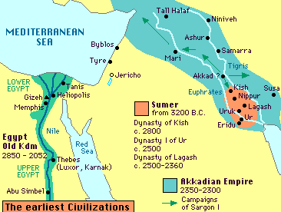
Sumer

Slide 17
Mesopotamia/Sumer
Sumerians Create City-States/Religion
The Sumerians exemplified the 5 characteristics of a civilization
Sumerians developed city-states: city that functioned like an independent country
Early government was controlled by temple priests
Ziggurat was a place of worship and like a town hall
In some cases, military leaders became full-time rulers and passed powers to sons
Dynasty: series of rulers from same family line
Cultural Diffusion: ideas or products spread from one culture to another through conquest and trade

Slide 18
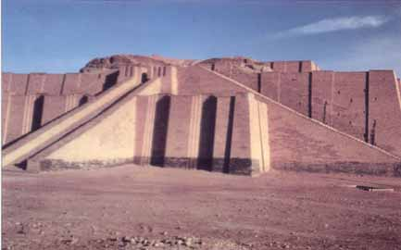
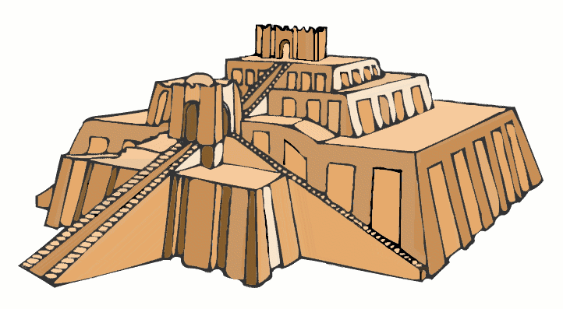
Ziggurat

Slide 19
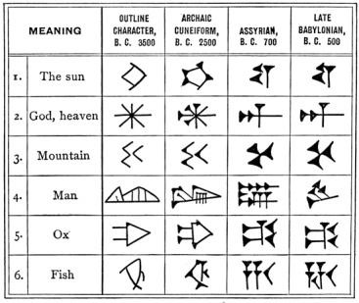
Writing/Main achievements
They developed the first system of writing- cuneiform. Wedge-shaped symbols . Early writing consisted of pictographs-symbols of the object or what they represented. Written on clay tablets.

Slide 20
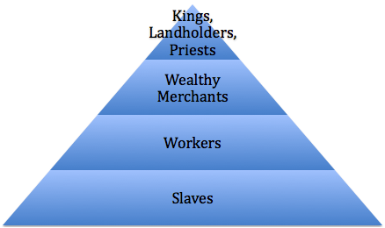
Mesopotamia/Sumer
Sumerian Culture/Social Structure/Religion
Sumerians were polytheistic: belief in more than one god
When you died you went to the “land of no return,” a dismal and gloomy place
Sumerians had social classes (see pyramid)
Sumerian women had more rights than many later Civilizations

Slide 21
Mesopotamia/Sumer
Advanced Technology/Math/Science
Ex: Ox drawn plows, potters wheel, sail, using bronze
Melt copper and tin together = bronze (more durable and malleable)
Developed a number system in base 60 (modern units for measuring time; 60 seconds = 1minute and 360 degrees of circle).

Slide 22
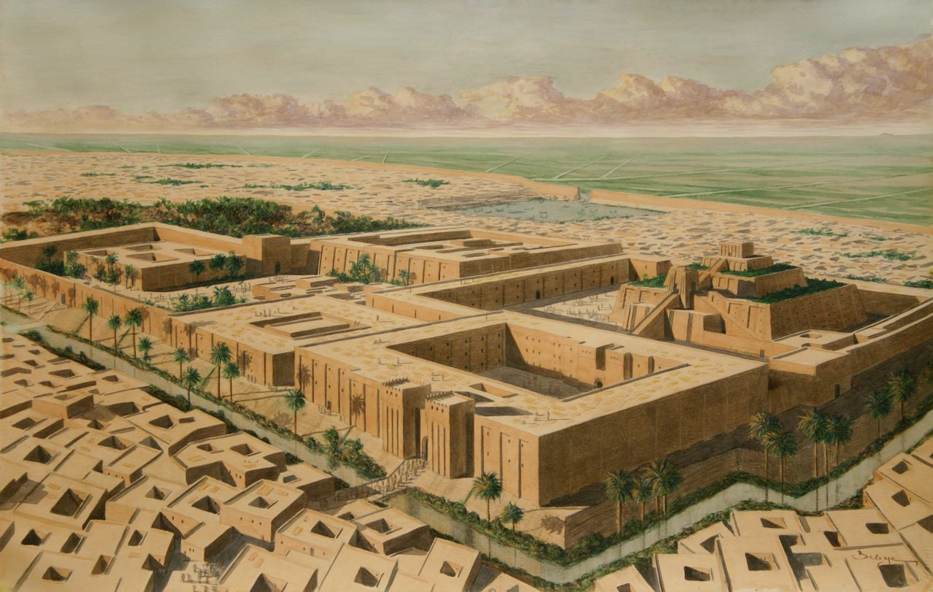

Slide 23
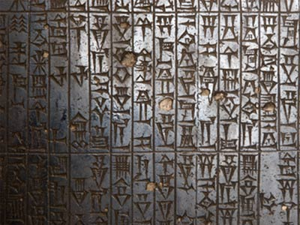
Mesopotamia/Sumer
Sargon of Akkad conquered Sumer in 2350 B.C.
Sargon created the world’s first empire: the bringing together of several peoples or nations under the control of one ruler.
Babylonian ruler Hammurabi came up with Hammurabi’s Code
Hammurabi’s Code: first written, uniform, set of laws engraved in stone to help unify diverse groups within his empire
READ HAMMURABI”S CODE

Slide 24
Hammurabi’s Code: Was it Just?
Task: With a partner, talk through the two cases below and write down answers to the questions in your notes. In each case, you will consider justice in three ways: Is the outcome fair to the accused? Is the outcome fair to the victim? Is the outcome in the best interest of the general society?
Case A:
Eddie is caught shoplifting a cell phone from Radio Shack. Eddis is 15 years old. It is his first offense. The police call his parents, and Eddie returns the phone. There will be no criminal record.
ASK:
Is it fair to Eddie?
Is it fair to Radio Shack?
Is it in the best interest of society?
Case B:
JD is caught shoplifting a cell phone from Radio Shack. JD is 19 years old. This will be his 3rd felony charge, all for shoplifting. Due to the Three Strikes Laws, his state requires that he serves a minimum of 10 years in prison with no chance at parole.
ASK:
Is it fair to JD?
Is it fair to Radio Shack?
Is it in the best interest of society?

Slide 25
Hammurabi’s Code: Was it Just?
Property Laws Document D:
21: If a man has broken through the wall to rob a house, they shall put him to death and pierce him, or hang him in the hole in the wall which he has made.
23: If the robber is not caught, the man who has been robbed shall formally declare whatever he has lost before a god, and the city and mayor in whose territory or district the robbery has been committed shall replace for him whatever he has lost
48: If a man has borrowed money to plant his fields and a storm has flooded his field or carried away the crop, in that year he does not have to his creditor.
53,54: If a man has opened his trench for irrigation an the waters have flooded his neighbor’s field, the man must restore the crop he has caused to be lost

Slide 26
Hammurabi’s Code: Was it Just?
Personal Injury Laws Document E:
196: If a man has knocked out the eye of a free man, his eye shall be knocked out.
199: If he has knocked out the eye of a slave he shall pay half his value.
209: If a man strikes the daughter of a free man and causes her to lose the fruit of her womb, he shall pay 10 shekels of silver.
213: If he has struck the slave-girl of a free man and causes her to lose the fruit of her womb, he shall pay 2 shekels of silver.
218: If a surgeon has operated with a bronze lancet on a free man for a serious injury, and has caused his death, his hands shall be cut off.

Slide 27
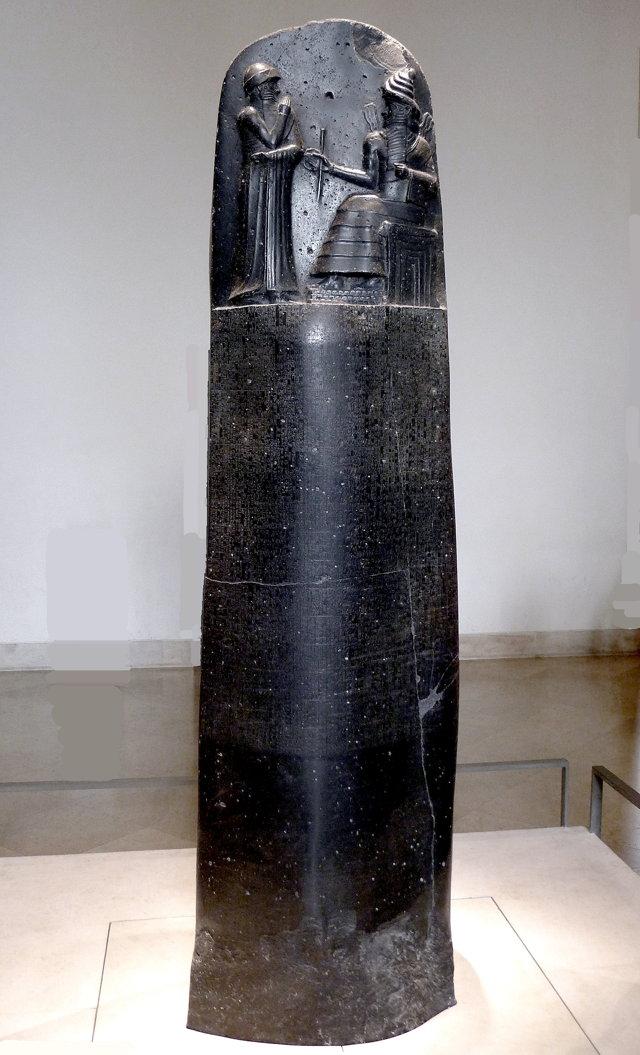
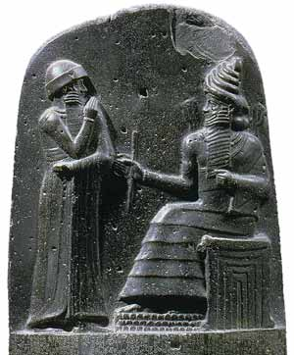
Rise of Civilization & Mesopotamia
Hammurabi’s Code
-What is the significance of have a written set of laws?

