Slide 1
DBQ: Absolutism and Democracy Monday 10/31
Objective:
Evaluate how government and people’s view of government evolved over time.
Warm-Up:
How did the Enlightenment (Age of Reason) change Europeans view of the World?
Agenda:
DBQ: Absolutism and Democracy
Essay: Absolutism vs. Democracy
Homework:
Goal Sheet: Unit 7, Due Wednesday, 11/2
CANVAS QUIZ: Unit 7, Fri 10/28-Wed 11/2

Slide 2
DBQ: Absolutism and Democracy
Step 1: Read each of the 6 documents and answer the questions that follow. Each of the documents relate to a different type of government.
Step 2: Take notes on the documents and answer the question in the space provided: How did governments and people’s view of government evolve over time?
Step 3: Write a well developed essay that answers the following question: Absolutism or Democracy; which type of government is the best form of government for a people to follow?

Slide 3
Essay Format
Paragraph 1 (Introduction):
Introduce your topic
Include a thesis (usually last sentence of introduction):
A thesis is a direct statement that explains the topic of your essay, what you believe about the topic, and why you believe it.
Thesis is made up of 3 parts:
1: Identification: what is the topic you are talking about?
2: Claim: What do you believe about the topic?
3: Direction: What are the 3 main reasons you support your claim (this outlines your body paragraphs).
Example: Do high school sports have a positive or negative influence on students?
High school sports have a positive influence on high school students because they teach social skills, reinforce time-management skills, provide exercise and show the benefits of hard work.

Slide 4
Essay Format
Paragraph 2, 3 and 4 (Body Paragraphs):
Discuss your first (body paragraph #2), second (body paragraph #3) and third (body paragraph #4) reasons (why you support your claim).
Use information from the documents to support/reinforce/provide evidence/give examples for your reasons. Make sure you refer to the document (give the author of the passage credit).
Example; According to document #3……, or In document #3 it states that……, or Document #3 claims that…..
Paragraph 5: Conclusion:
Restate your thesis.
Recap 3 reasons

Slide 5
Essay: Absolutism vs. Democracy
Format:
12 font
Double spaced
Times New Roman
Due Date: Wednesday, 11/2
Upload to Turn it In ☺

Slide 6
Area | Mastery | Approaching | Developing | Not Evident
Focus and Organization (Your position) | States a precise claim focused on the prompt (40 pts.) | States an adequate claim that is related to the prompt, but may have elements that are not related to the prompt (35 pts.) | States a weak claim that is only somewhat related to the prompt or is highly unfocused (25 pts.) | Provides a claim that is not related to the prompt or does not have a claim at all (0 pts.)
Evidence (Proof) | Develops claim thoroughly by supplying the most relevant evidence and/or examples (use documents) (40 pts.) | Develops claim adequately by supplying mostly relevant evidence and/or examples (35 pts.) | Develops claim ineffectively by supplying evidence and/or examples with limited relevance (25 pts.) | Does not develop claim. (0 pts.)
Elaboration (Why and how) | Clearly integrates multiple sources (outside knowledge) (20 pts.) | Adequately integrates multiple sources (15 pts.) | Minimally integrates multiple sources (10 pts.) | Does not use more than one source. (0 pts.)

Slide 7
Turn it in.com
Mrs. Nicholson’s World History Period 1
Class ID: 13913008
Enrollment Password: Period1
Mrs. Nicholson’s World History Period 2
Class ID: 13913236
Enrollment Password: Period2
Mrs. Nicholson’s World History Period 3
Class ID: 13913251
Enrollment Password: Period3

Slide 8
Day 5: The Enlightenment
Question:
How did the “Enlightenment” (Age of Reason) change Europeans view of the World?
Warm-Up:
Read John Locke “Two Treatises on Government.” Answer question #1.
Objective:
Explain how new ideas and theories of the universe changed political thought and affected social conditions.

Slide 9
The Enlightenment Friday 10/28
Objective:
Explain how new ideas and theories of the universe changed political thought and affected social conditions.
Warm-Up:
What was The Scientific Revolution and how did it change how people viewed the World?
Agenda:
PPT/Notes: The Enlightenment
Activity: Analyze quotes (with partner)
Homework:
Goal Sheet: Unit 7, Due Wednesday, 11/2
CANVAS QUIZ: Unit 7, Fri 10/28-Wed 11/2

Slide 10
The Enlightenment
Aim:
How did the “Enlightenment” (Age of Reason)
Change European’s view of the World?

Slide 11
The Enlightenment
Use pages: 629-634
Fill in the graphic organizer by describing the beliefs of the Enlightenment thinkers. There should be at least three facts per philosopher.

Slide 12
Directions
Number a piece of paper 1-10
If you agree with the following statement, give yourself a 1, if not give yourself a zero, there is no maybe or not sure…
1) 1
2) 0
3) 0

Slide 13
There should not be any laws regarding drug use
The government should not provide food stamps
The government should not provide welfare
There should be no minimum wage
The government should not provide social security

Slide 14
6) There should not be any laws regarding sex between consenting adults
7) The government should not provide public schools
8) There should never be a military draft, regardless of national emergencies
9) The government should not provide health care
10) Government should not help industries or farms at risk of failure.

Slide 15
Admittedly simplistic Results!
Add up your numbers
If your number is 6 or more, you are not a big fan of government and would like to limit its power
If your number is 4 or less, you like the government being involved in its citizens lives

Slide 16
The Enlightenment
The ideas of the Enlightenment grew out of the Scientific Revolution
Enlightenment ideas helped bring about the American and French Revolutions.

Slide 17
The Enlightenment:
Causes Results
Scientific Revolution 1) Political Revolutions
French Philosophers 2) Growth & Spread of Democracy
3) Spread of
Nationalism
4) Enlightened Despot (Absolute rulers who reform social, legal, and educational institutions)

Slide 18
Enlightenment: a new intellectual movement that emphasized reason and thought and the power of individuals to solve problems.
Philosophes believed you could apply reason to all aspects of life
Reason – truth could be discovered through reason or logical thinking
Nature – what was natural was good and reasonable
Happiness – well-being on earth and following nature’s laws lead to happiness
Progress – people use scientific approach, life could now be perfected
Liberty – through reason, society could be set free.

Slide 19
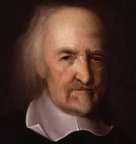
“The Condition of man (in the state of nature)…. Is a condition of war of everyone against everyone”
Thomas Hobbes
Wrote: Leviathan
all humans were naturally cruel, greedy selfish and wicked. They need to be controlled.
Idea of Social Contract
People give up their rights to a strong ruler in exchange for law and order
What type of government would he favor?
Absolute monarchy b/c it imposed order and demanded obedience.
CONNECTION TO TODAY?

Slide 20
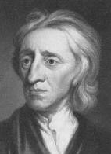
John Locke
Two Treatises on Government
More positive; all people could learn from experience and improve themselves. Believed people were reasonable and moral.
People are born free and equal with THREE natural rights:
Life
Liberty
Property
Purpose of government is to protect these rights. Gov’t has limited power and could be overthrown.
CONNECTION TO TODAY?

Slide 21
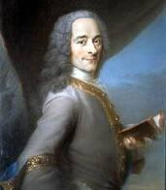
“My Trade is to say what I Think” “I do not agree with a word that you say, but I will defend to the death your right to say it”
Voltaire
Freedom of Speech
Used wit/satire as a weapon to expose abuses; targeted clergy, aristocracy, and government
Wrote about inequality, injustice, and superstition.
Detested slave trade and religious intolerance
“Ecrazes l’infame!” “Crush the evil thing!”
Forced into Exile
What Film Maker today tries to expose corruption through his art?
CONNECTION TO TODAY?

Slide 22
Montesquieu
Believed English government, like Voltaire, was the best government
Power spread across three groups of officials.
Came up with the idea of separation of powers.
Executive power: King and ministers → enforce laws
Legislative power: Parliament → create laws
Judicial: English courts → interpreted laws to see how each applied to a specific case.
System of checks and balances: each branch would serve as a check on the other two.
What are some examples?
CONNECTION TO TODAY?

Slide 23
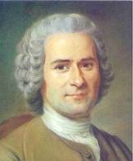
“Man is born free, and everywhere he is in chains.”
Rousseau – Champion of Freedom
Individual freedom
Very different from other philosophes
Civilization corrupted people’s natural goodness
Only good government was one that was freely formed by the people and guided by the “”general will” of society
Which is what?
Direct democracy
People agree to give up some of their freedom in favor of the common good.
His Social Contract was between a society and government
Agreement among free individuals to create a society and a government.
All people are equal and titles of nobility should be abolished.
CONNECTION TO TODAY?

Slide 24
Bocc – criminal justice
Laws existed to preserve social order, not to avenge crimes
On Crimes and Punishments
Criticized common abuses of justice
Including torture, punishments that were cruel and arbitrary
Argued that people accused of crime should be given a speedy trial
NEVER use torture
Degree of punishment should be based on the seriousness of crime
Capital punishment should be abolished.
CONNECTION TO TODAY?

Slide 25
Women and the Enlightenment
Even though this was a great time of progress, women were still seen in the traditional view
Mary Wollstonecraft
Argued that the environment, not nature, made women seem shallow and intellectually limited.
1st duty is to be a mother, but she should be able to decide what is in her own best interest and not be completely dependent on husband.
Argued that women, like men, need education to become virtuous and useful
Women should have rights in politics
“If absolute sovereignty be not necessary
In a state, how come it is to be so in a
Family?....If all men are born free, how is
It that all women are born slaves?”

Slide 26
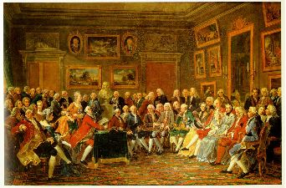
Spread of Enlightenment
Parisian SALONS– the gateway to Enlightenment
Philosophers, writers, artists, scientists met to discuss ideas and enjoy artistic performances.
Helped lead to the creation of the first set of ENCYCLOPEDIAs
Denis DIDEROT
Salons and the Encyclopedia helped educate people all over Europe

Slide 27
Impact of Enlightenment
Through reasoning, Enlightenment thinkers examined principles of divine right, union of church and state, and unequal social classes and found them unreasonable.
Although they look the part, they are not active revolutionaries but they do inspire those who lead them
E.g. America and France
Three Long-term Effects:
Belief in Progress:
Growth of sci. knowledge quickened in 1700s
Scientists found multiple discoveries in chemistry, physics, biology, and mechanics
More Secular Outlook:
Scientists wanted to reveal God’s majesty through mathematics
Did not want to upset the church
Importance of the Individual:
People began to look at themselves for guidance, not the church.

Slide 28
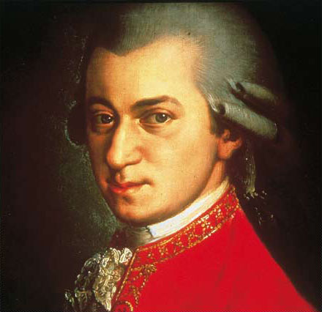
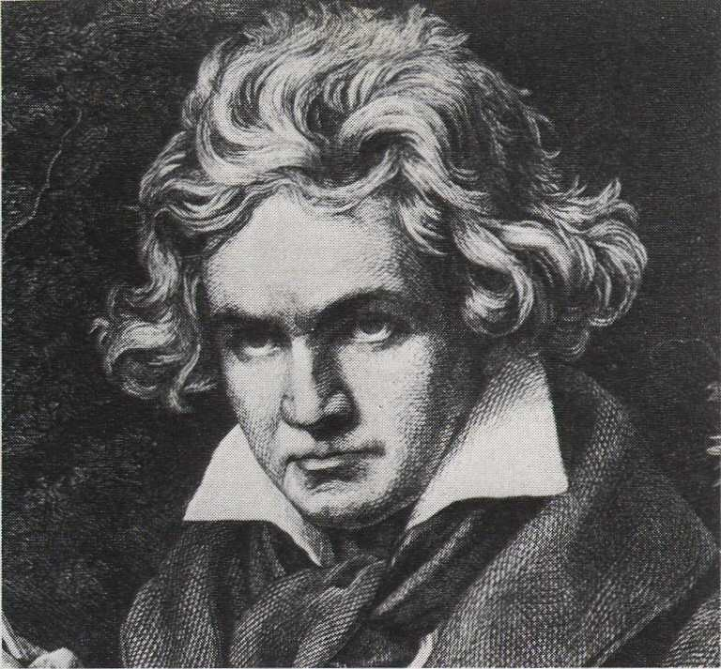
Enlightenment Music
Mozart
Beethoven

Slide 29
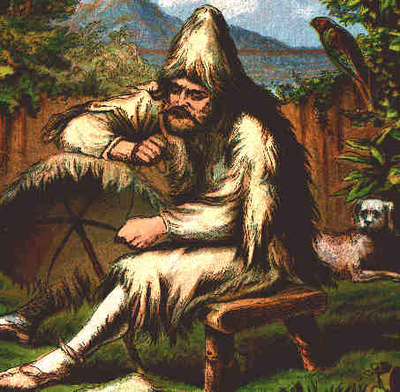
Enlightenment Literature
Novels: Entertaining stories written for everyone, using common language, e.g. Robinson Crusoe, by Defoe

Slide 30
Enlightened Despots
Citizens exist
to serve the Monarchy exists
Monarchy to serve citizens
Frederick the Great (Prussia)
Joseph II (Austria)
Catherine the Great (Russia)
Were all influenced by Enlightenment ideas to try to reform their empires and provide some equality and help to the poor
Enlightenment Ideas

Slide 31
Turning point: The Enlightenment changed EVERYTHING
Inspired the American Revolution
American Revolution inspired French Revolution… which led to European nationalism
Improved women’s rights
Increased educational opportunities
Led to the Industrial Revolution
Religious freedom
Abolishment of torture

Slide 32
The assignment:
Write a 1 page statement of how you would organize society.
What type of government?
What would be the role of government?
What would be the role of citizens?
Which Enlightenment philosopher's ideas would you use (at least 2)? Explain in detail
Which E.P.’s ideas would you definitely not use (at least 1). Explain in detail
If you are committed to a form of government unrelated to the Enlightenment, you must cogently explain your position.

Slide 33
Enlightened Despots
Some rulers followed the philosophes ideas of respecting the people’s rights.
Two desires:
Make countries stronger
Own rule to be more effective.
Most well known were Frederick II of Prussia, Joseph II of Austria, and Catherine the Great of Russia
Frederick the Great
Called himself the “first servant of the state.” Goal was to serve and strengthen gov’t.
Joseph II → most radical
Legal reforms. Freedom of the press and worship.
Abolished serfdom.
All reforms undone after death
Catherine the Great
Wished for major reforms
Never came and gave loyalty to nobles.

Slide 34
Enlightenment Flashcards
Create a flashcard for each of the below people from the Age of Reason. On one side of the card put the name of the person and on the other side put who they were, why they were so important, and/or what they invented.
Montesquieu
Thomas Hobbes
John Locke
Voltaire
Rousseau
Beccaria
Wollstonecraft
Frederick II
Joseph II
Catherine the Great

