Slide 1
Journal Entry: Friday 11/18
Objective:
Describe Africa before European domination
Summarize the motives of European colonizers and the factors that allowed them to control Africa
Warm-Up/Journal Entry Question:
Think back to a time when you may have tried to dominate someone younger, smaller, or weaker. How did you assert your power?
Agenda:
Return TEST: Unit 9, Ind. Rev.
Map Activity: Imperialism
PPT/Notes: Imperialism in Africa
Homework:
Goal Sheet; Unit 10, Imperialism: Due Thurs 12/1
TEST: Unit 10, Imperialism: Thurs 12/1

Slide 2
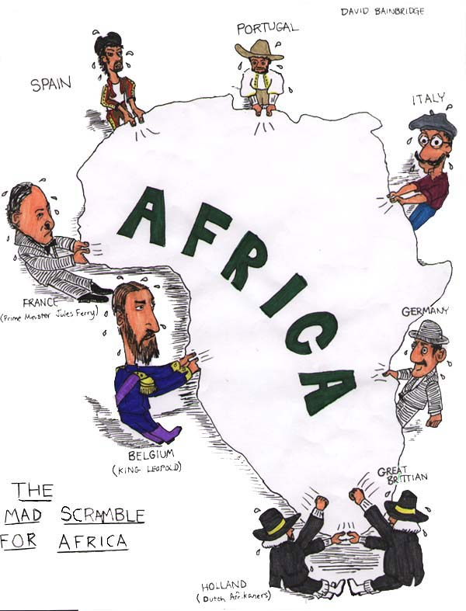
Imperialism to Independence
Outcome: Imperialism in Africa

Slide 3
Looking Back - Review
What is required for nation to industrialize?
1 – Factors of Production (land, labor, capital)
2 – Political Stability
3 – Transportation network
4 – Trading Markets
What is the incentive for a nation to industrialize?
1 – WEALTH
2- Power & Nationalism
3 – Spreading of culture

Slide 4
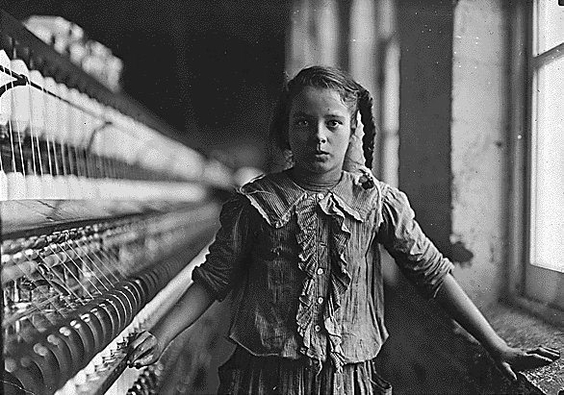
Industrial Revolution
CAUSES:
Agricultural Revolution
Increased demand for goods
New inventions
DEFINITION: Age of increased output of machine-made goods
WHERE:
England
Then around Europe
United States (Beginning in New England)

Slide 5
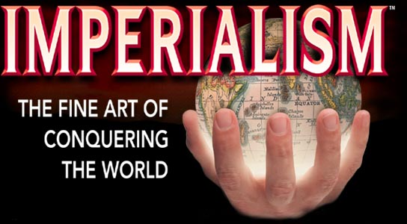
IMPERIALISM
DEFINITION: the takeover of a country or territory by a stronger nation with the intent of dominating the political, economic, and social life of natives.
WHO:
England
Italy
France
Germany
Spain
Portugal
Belgium
USA

Slide 6
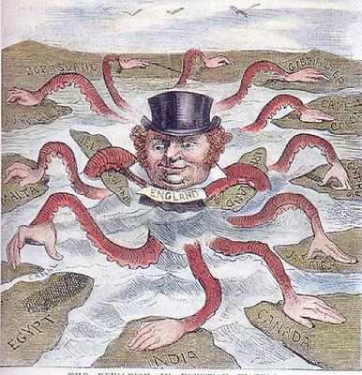
Devilfish in Egyptian Waters
Why do you think this cartoon
earned such a title?
What does this cartoon say about
England and Imperialism?
What is about to occur in the
picture?

Slide 7
African Trade [15c-17c]

Slide 8
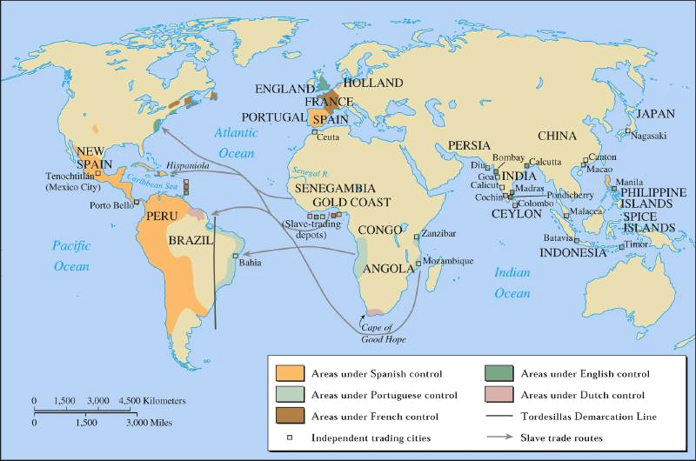
Pre-19c European Trade with Africa

Slide 9
The Age of Imperialism in Africa
Setting the Stage: Layers of History
Ancient Egyptians and Nubians in the north left Africa with impressive ruins
Rule by the Persians and Greeks spread culture
The Ottoman Empire brought Islam
The Roman Empire controlled northern Africa after the defeat of Carthage

Slide 10
European Nationalism
Source for
Raw
Materials
Industrial
Revolution
Missionary Activity
European
Motives
For Colonization
Markets for Finished Goods
Military & Naval Bases
Social Darwinism
European Racism
Places to Dump Unwanted/ Excess Popul.
Humanitarian Reasons
Soc. & Eco. Opportunities
“White Man’s Burden”

Slide 11
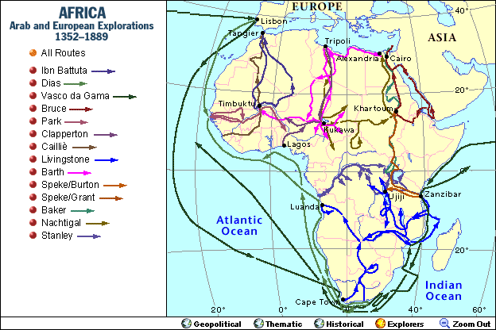
European Explorers in Africa
19c → Europeans Map the Interior of Africa

Slide 12
The Age of Imperialism in Africa
Imperialism
Prior to European domination, African people were divided into hundreds of ethnic and linguistic groups and continued to follow traditional beliefs
Some converted to Islam and Christianity
Due to industrialization, Europeans competed for new markets to buy goods
This led to European imperialism in Africa in the 19th and 20th centuries
Imperialism: the seizure of a country or territory by a stronger country
Disease and African armies had discouraged European exploration in the past
Humanitarians, explorers, and missionaries who were against the Atlantic Slave Trade were allowed to travel to the interior
In the 1860s, David Livingstone, a missionary from Scotland travelled to Africa
Feared dead, American Henry Stanley found Livingstone in near Lake Tanganyika and his greeting “Dr. Livingstone, I presume?” became world famous
Stanley’s further exploration of the Congo sparked the interest of King Leopold II of Belgium who took control of these lands with treaties and exploited the people

Slide 13
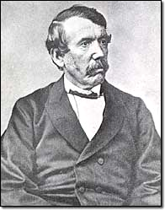
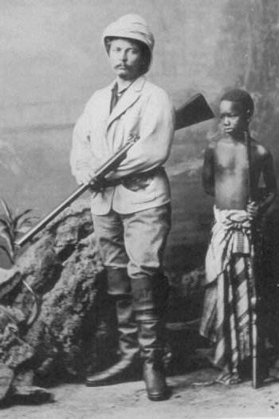
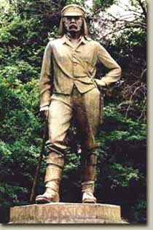
Where Is Dr. Livingstone?
Doctor Livingstone, I Presume?
Sir Henry Morton Stanley
Dr. David Livingstone

Slide 14
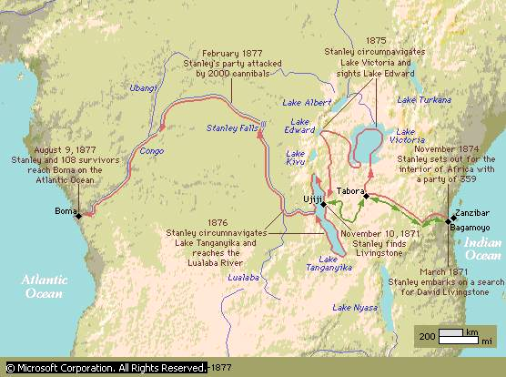
European Explorations in mid-19c: “The Scramble for Africa”

Slide 15
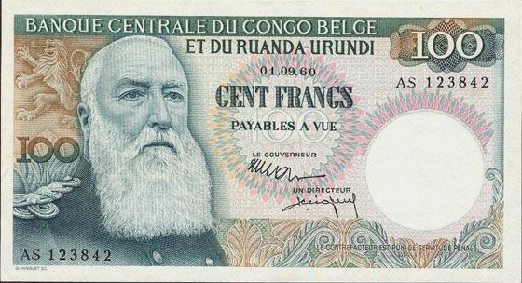
King Leopold II: (r. 1865 – 1909)

Slide 16
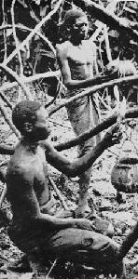
Harvesting Rubber

Slide 17
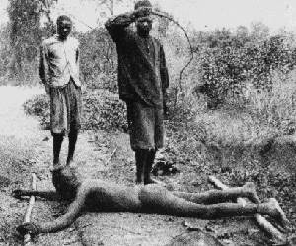
Punishing “Lazy” Workers

Slide 18
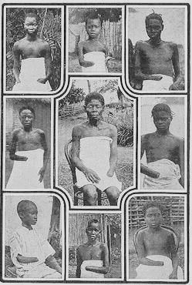
5-8 Million Victims! (50% of Popul.)
It is blood-curdling to see them (the soldiers) returning with the hands of the slain, and to find the hands of young children amongst the bigger ones evidencing their bravery...The rubber from this district has cost hundreds of lives, and the scenes I have witnessed, while unable to help the oppressed, have been almost enough to make me wish I were dead... This rubber traffic is steeped in blood, and if the natives were to rise and sweep every white person on the Upper Congo into eternity, there would still be left a fearful balance to their credit. -- Belgian Official

Slide 19
Journal Entry: Monday 11/21
Objective:
Describe Africa before European domination
Summarize the motives of European colonizers and the factors that allowed them to control Africa
Warm-Up/Journal Entry Question:
Go over the Belgian Congo questions/reading
Agenda:
Continue PPT/Notes: Imperialism in Africa
Group Activity: Berlin Conference
Homework:
Goal Sheet; Unit 10, Imperialism: Due Thursday 12/1
TEST: Unit 10, Imperialism: Thursday 12/1

Slide 20
IMPERIALISM –Why/Motives:
1.) Economic Interests
Industrial Revolution: Nations did not have enough resources in their own countries (ex. rubber, steel, petroleum)
Industrial nations made so much extra stuff they needed new markets of consumers to sell goods
2.) Political and Military
Merchant ships and naval vessels needed bases to take on coal and supplies.
Nationalism: There was heated rivalries between countries
More colonies = more power!
i.e. Doing people a “favor” by making them more British
3.) Humanitarian and Religious goals
Missionaries and doctors felt they had a duty to help their “little brothers” and spread medicine, law, Christian religion; “The blessings of Western Civilization.”

Slide 21
The Age of Imperialism in Africa
4. Social Darwinism
National pride led to the desire for more colonies
Europeans viewed an empire as a measure of national greatness
Simply put: Europeans believed they were better than other peoples; racism
Based on Charles Darwin’s “Survival of the Fittest,” European attitudes were a reflection of a social theory known as Social Darwinism
Essentially they believed those who were the fittest for survival enjoyed wealth and success and were considered superior to others
This colonization push also came from missionaries looking to spread Christianity
Railroads, maxim gun, and quinine for malaria helped Europeans push into Africa

Slide 22
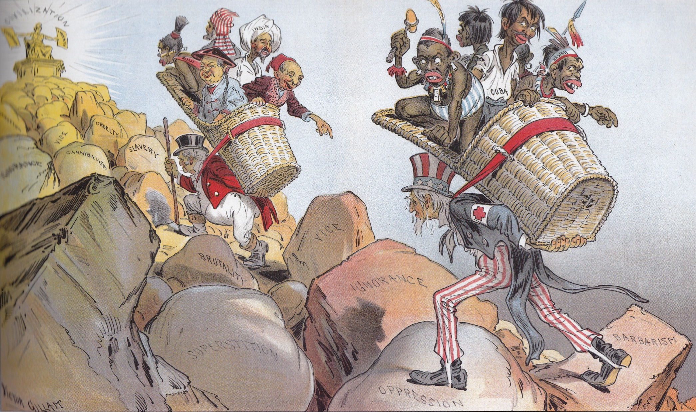
EXAMPLE 1: Judge, 1899

Slide 23
Against Social Darwinism

Slide 24
The Age of Imperialism in Africa
5. The Berlin Conference
The discovery of diamonds in 1867 and gold in 1886 in South Africa increased European interest in colonization
To prevent war, 14 European nations met at the Berlin Conference in 1884-85 to lay down rules for the division of Africa
They agreed that any European nation could claim land by notifying other nations and showing they could control that land
Very little thought was given to how the African groups would react
No African ruler was invited
By 1914, only Liberia and Ethiopia remained free of European control

Slide 25
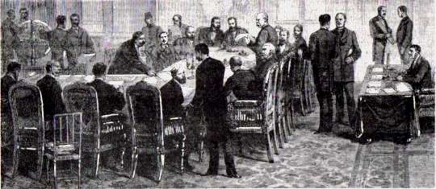
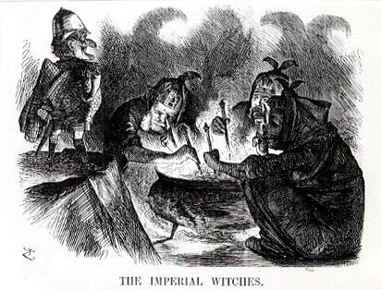
Berlin Conference of 1884-1885
Another point of view? →

Slide 26
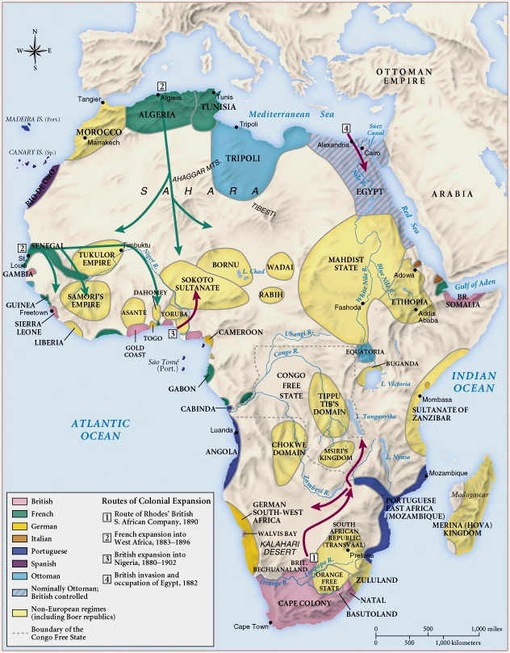
Africa
1890

Slide 27
Berlin Conference Activity
Use pages:
771
777
214
A16, A17, A36, A37, A38

Slide 28
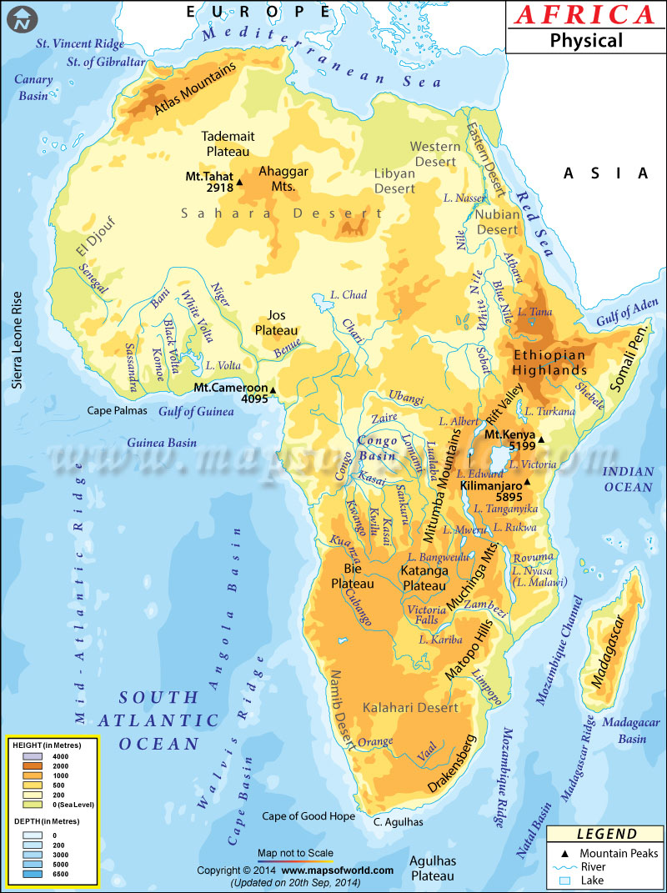

Slide 29
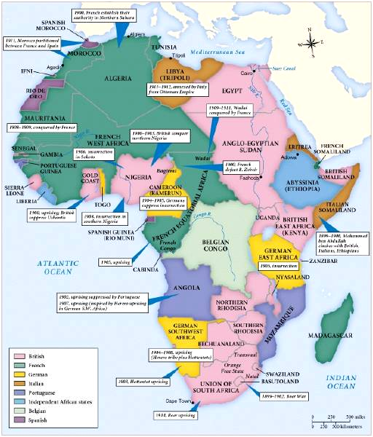
Africa
in
1914

Slide 30
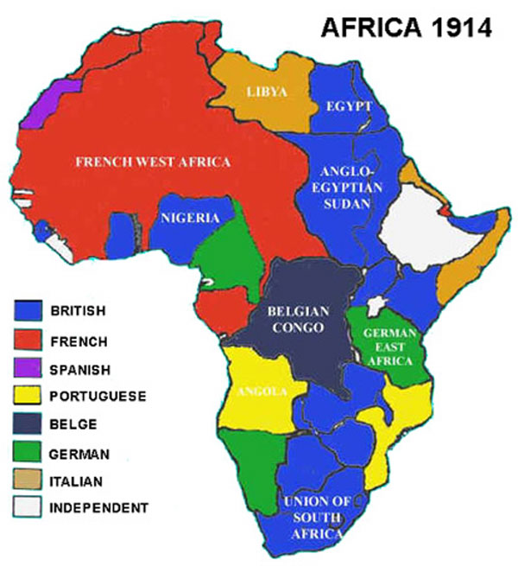
IMPERIALISM IN AFRICA
By 1914 African continent almost entirely controlled by European imperial powers
Took control of economy, society, government of the conquered peoples

Slide 31
Journal Entry: Tuesday Nov 22
Objective:
Describe Africa before European domination
Summarize the motives of European colonizers and the factors that allowed them to control Africa
Warm-Up/Journal Entry Question:
Read, Rudyard Kipling’s “The White Man’s Burden,” 1899. Answer questions that follow.
Agenda:
Continue PPT/Notes: Imperialism in Africa
DBQ: Imperialism in Africa
Homework:
Goal Sheet; Unit 10, Imperialism: Due Thursday 12/1
TEST: Unit 10, Imperialism: Thursday 12/1

Slide 32
Views on Partition of Africa
Cecil Rhodes in Favor:
“I contend that we are the first race in the world and that the more of the world we inhabit the better it is for the human race. I contend that every acre added to our territory provides for the birth of more of the English race, who otherwise would not be brought into existence……. I believe it to be my duty to God, my Queen, and my country to paint the whole map of Africa red, red from the Cape to the Cairo. That is my creed, my dream my mission.”
Chief Kabongo of Kenya Opposing:
“ A Pink Cheek man came one day to our Council… and he told us of the King of the Pink Cheek who… lived in a land over the seas. ‘This great King is now your King,’ he said. This was strange news. For this land was ours… We had no king, we elected our Councils and they made our laws. With patience, our leading Elders, tried to tell this to the Pink Cheek… But at the end he said, “This we know but in spite of this what I have told you is a fact.. You have now a king… and his laws are now your laws.”
What is Cecil Rhode’s argument for imperialism?
What is Chief Kabongo’s argument against it?

Slide 33
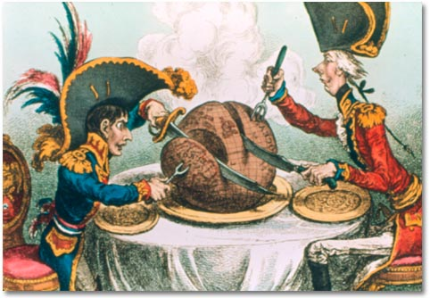
“All great nations in the fullness of their strength have desired to set their mark upon barbarian lands and those who fail to participate in this great rivalry will play a pitiable role in time to come.”
- Heinrich von Treitschke

Slide 34
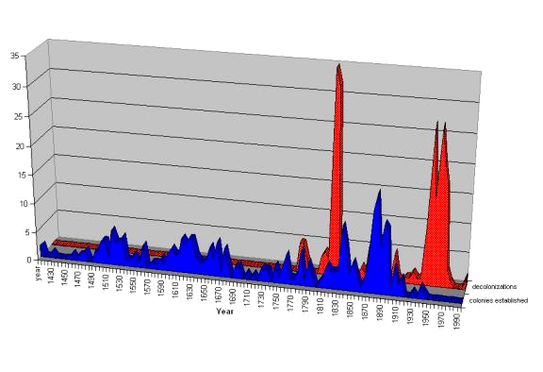
European Colonization/Decolonization Patterns
Berlin Conference of 1884-85

Slide 35
European Advantages/African Vulnerability
Strong economies, well-organized governments, and powerful armies and navies.
Superior technology: riverboats, telegraph, medical knowledge, and the MAXIM GUN; in 1885, it was the first fully automatic machine gun. It could fire 500 rounds per minute, about as many as 100 rifles (Africans and Asians had no weapons to equal the Maxim gun).
In West Africa, the slave trade had undermined established empires, and there were many wars among African people (no unification)
Newer African states were not strong enough to resist the Western onslaught

Slide 36
The Age of Imperialism in Africa
Clash over South Africa
The Zulus under leader Shaka fought bravely against the British
Zulus almost win but the Zulu nation fell to Britain in 1887
Dutch settlers known as Boers settled the Cape of Good Hope in 1652
Fought the British when the British took over
Led to the Boer War between the British and the Boers
Britain finally won and created the Union of South Africa in 1910

Slide 37
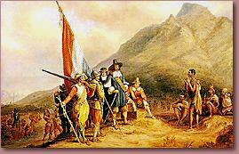
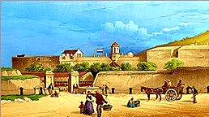
Dutch Landing in 1652

Slide 38
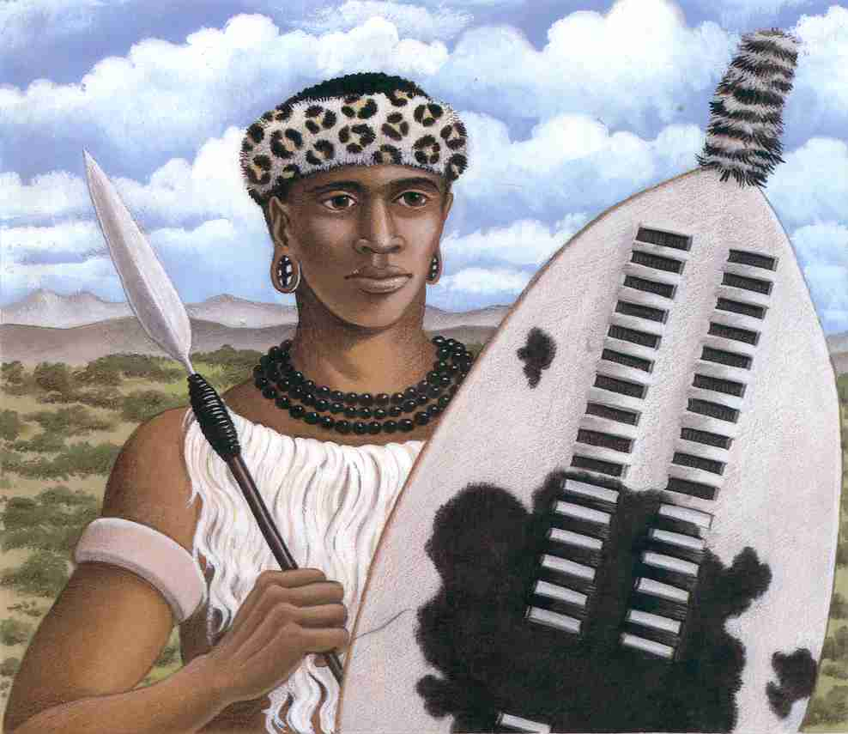
Shaka Zulu (1785 – 1828)

Slide 39
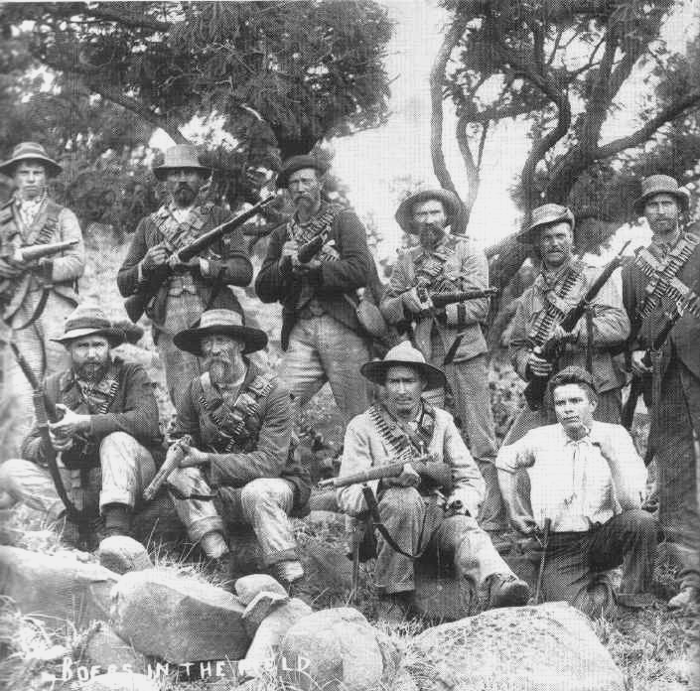
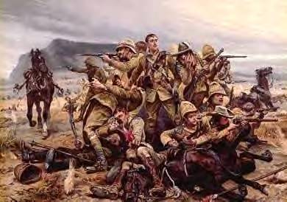
The Boer War: 1899 - 1900
The British
The Boers

Slide 40
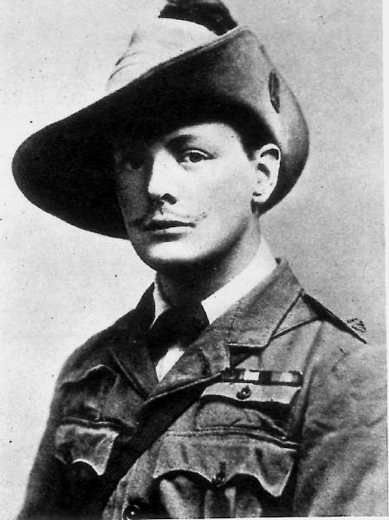
A Future British Prime Minister
British Boer War Correspondent, Winston Churchill

Slide 41
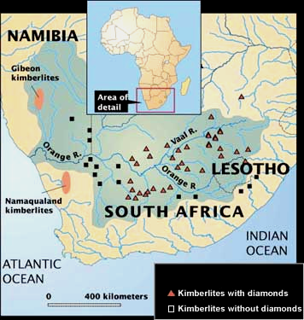
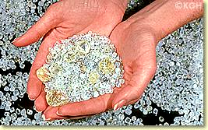
Diamond Mines
Raw Diamonds

Slide 42
The Age of Imperialism in Africa
Legacy of Colonial Rule
Negative Effects
Africans lost control of their lands and their independence
Many died of smallpox
Thousands died resisting European rule
Traditional culture broke-down
Division of Africa combined or unnaturally divided groups
Valuable goods such as gold, salt, and diamonds were taken out of the continent as well as the profit that was made

Slide 43
The Age of Imperialism in Africa
Positive Effects
Reduced local warfare
Sanitation was provided; hospitals & schools built
Life spans and literacy rates increased
Railroads, dams, and telephone/telegraph wires were built; mostly benefitted Europeans

Slide 44
Constructive Response Questions
Describe what the European motivations for colonizing Africa were:

